Slide 1

Fetal Health Prediction
GRACE SIGALLA, GOWTHAM VADDANAM, SREEREKHA RAJENDRAN
DSCI 631 SPRING 2022

Slide 2
Table of Contents
Context
Goals
Dataset used
Exploratory Data Analysis
Implementation
Results
Challenges

Slide 3
Context
Child mortality reduction is an important indication of human development and is reflected in several of the United Nations' Sustainable Development Goals.
By 2030, the United Nations wants nations to have eliminated avoidable deaths of newborns and children under the age of five, with all countries aiming to decrease under-five mortality to at least 25 per 1,000 live births.
Maternal mortality, which accounts for 295000 fatalities during and after pregnancy and delivery, runs parallel to the concept of child mortality (as of 2017).
The great majority of these deaths (94%) happened in low-resource areas, and the majority of them could have been avoided.

Slide 4
Context
Cardiotocograms (CTGs) are a straightforward and inexpensive way for healthcare practitioners to monitor fetal health and take measures to reduce child and mother death.
The machine sends ultrasound pulses and reads the response, providing information on the fetal heart rate (FHR), fetal movements, so on.

Slide 5
Goals
Our main aim in this project is to use machine learning to classify and predict fetal health which in turn can prevent fetal and maternal mortality.
We intend to use classification algorithms to achieve the lowest error in prediction.

Slide 6
Data
The dataset chosen for this project has features extracted from Cardiotocogram exams and classified by expert obstetricians.
Source: Ayres de Campos et al. (2000) SisPorto 2.0 A Program for Automated Analysis of Cardiotocograms. J Matern Fetal Med 5:311-318
Link to Dataset: https://www.kaggle.com/code/karnikakapoor/fetal-health-classification/data

Slide 7
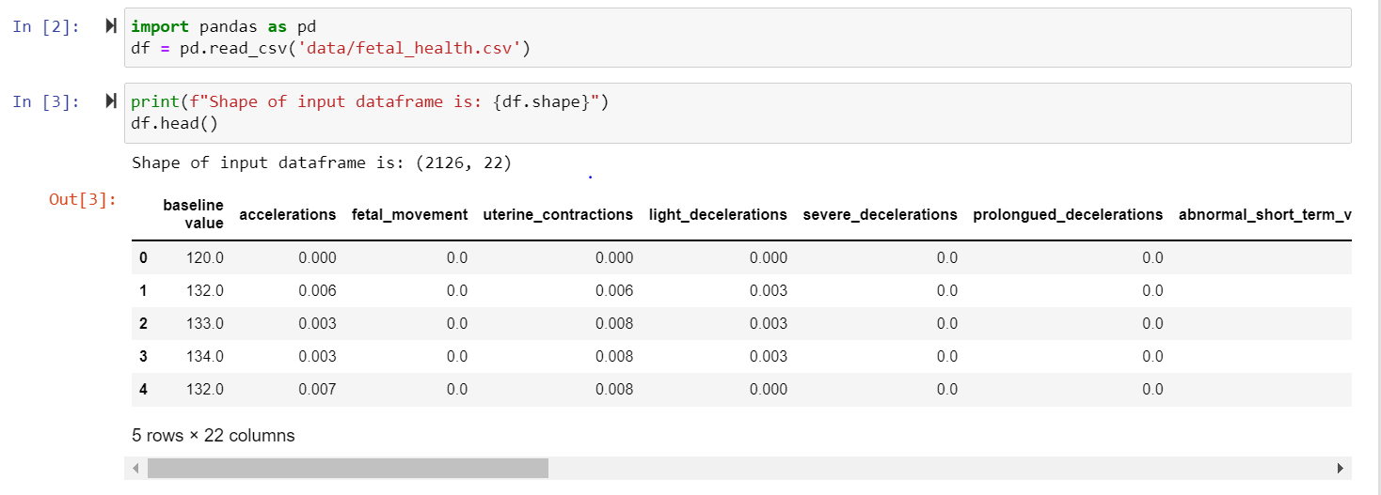
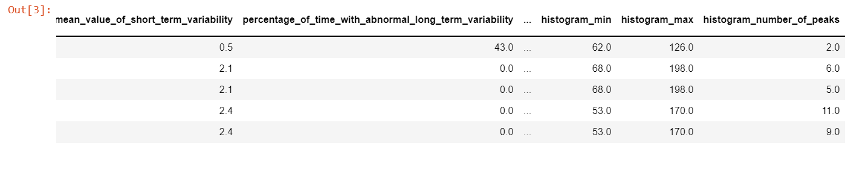
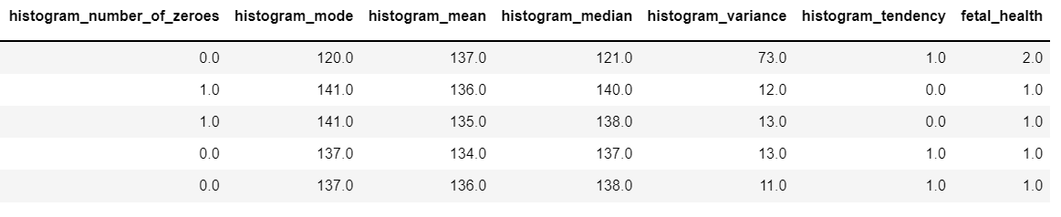

Slide 8
Dataset Description
The dataset contains 22 columns and 2126 records.
It only contains continuous values. None of the columns have categorical values.
All features have non-null values and hence we didn’t have to drop or impute.

Slide 9
Exploratory Data Analysis

Slide 10
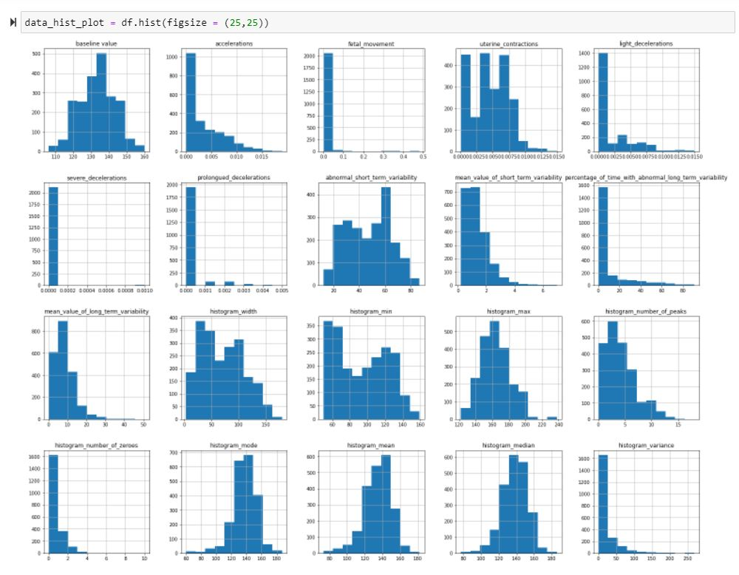

Histograms

Slide 11
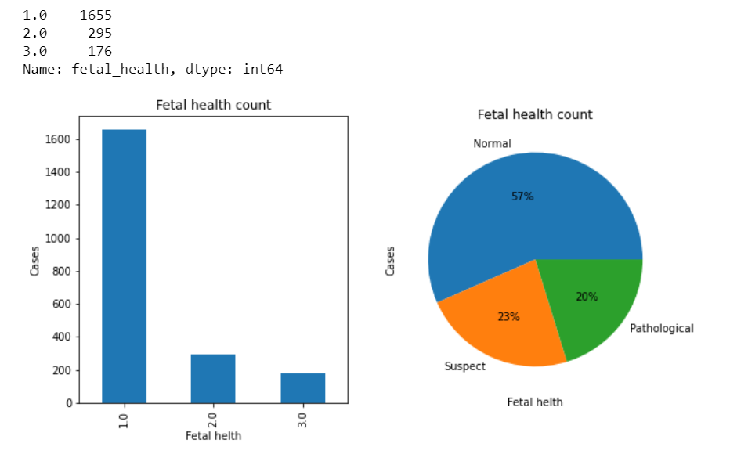
Fetal Health classes

Slide 12
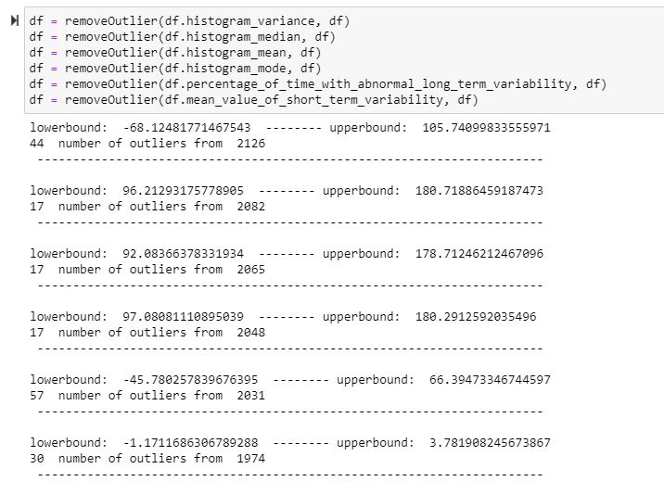
Outlier Detection/Removal

Slide 13
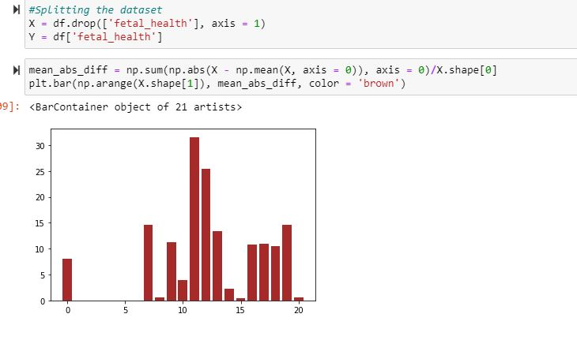
Feature Selection
Mean Absolute Error (EAD)

Slide 14
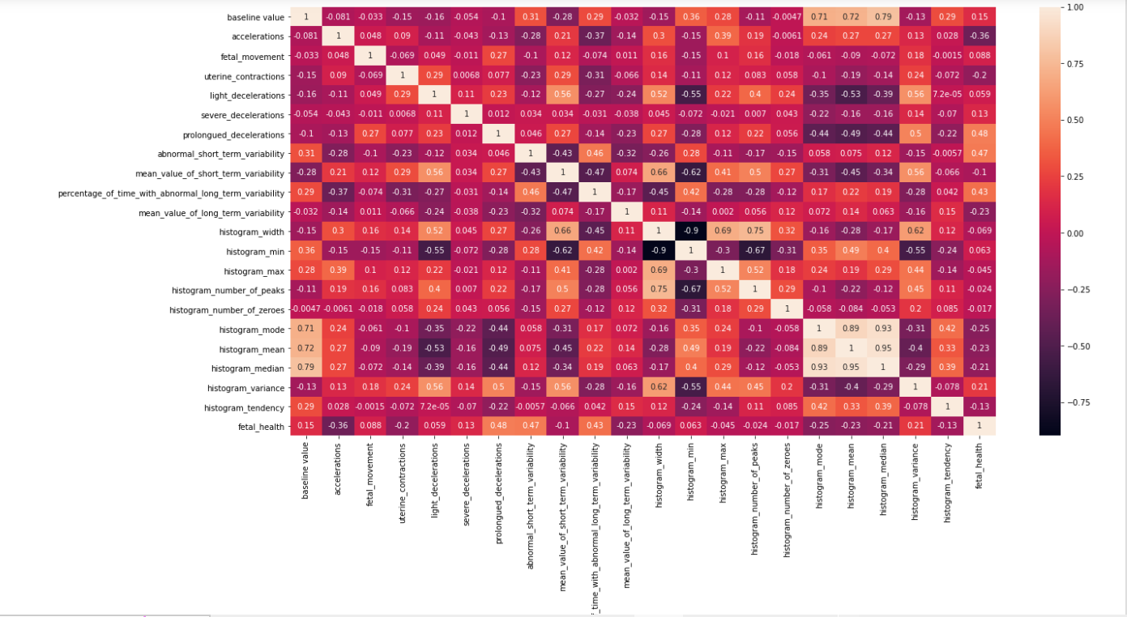
Correlation Matrix

Slide 15
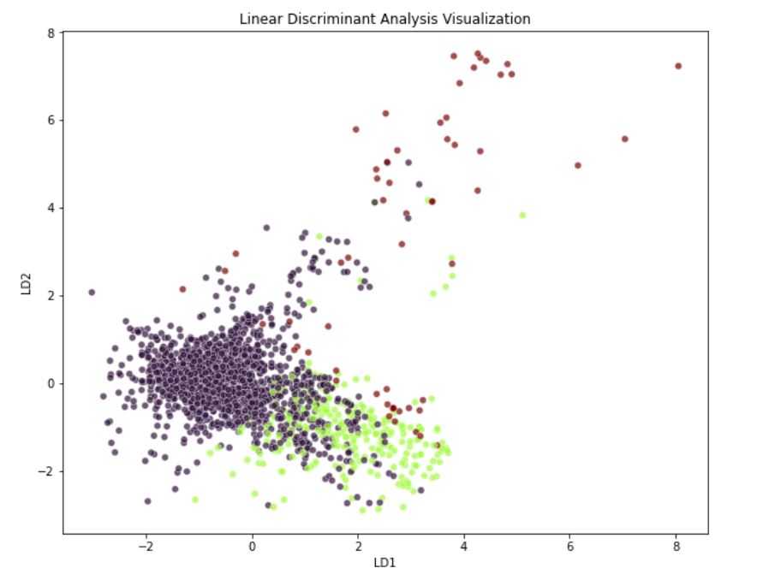
Dimensionality Reduction
Linear Discriminant Analysis (LDA)

Slide 16
Observations
1. From the pathological records, the features of fetal movements, uterine contractions, and the interval range of heart rate values strongly correlated with deceleration rates in higher proportions.
2. Among the suspect and normal records, the plots representing the increased accelerations but not deceleration. Therefore, both pathological and suspect records achieving more decelerations.
3. Pathological records have higher values of percentage of time with long term variability and abnormal short-term variability.
4. Pathological records have lower metrics for mode, median, and mean for cardiotocography exams among their graph tendencies, while normal records have higher values for these metrics. This correlates with their cardiotocography graphs.
5. There were a lot of outliers, therefore we decided to remove the outliers as they represent a measure of error.
6. No categorical features, all are numerical.
7. All other features other than 'fetal_health' are going to be our predictors and no feature is imputed.

Slide 17
Implementation

Slide 18
Algorithms applied
In this project, our goal is to build classification task for predicting the child mortality and maternity mortality. For this we used the following models.
Logistic regression
Random Forest
K-nearest neighbors (KNN)

Slide 19

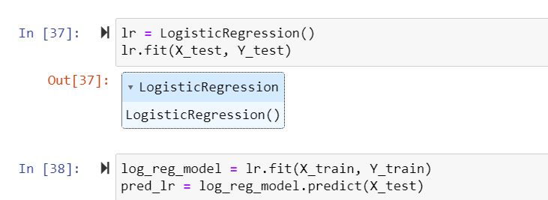
Logistic Regression

Slide 20
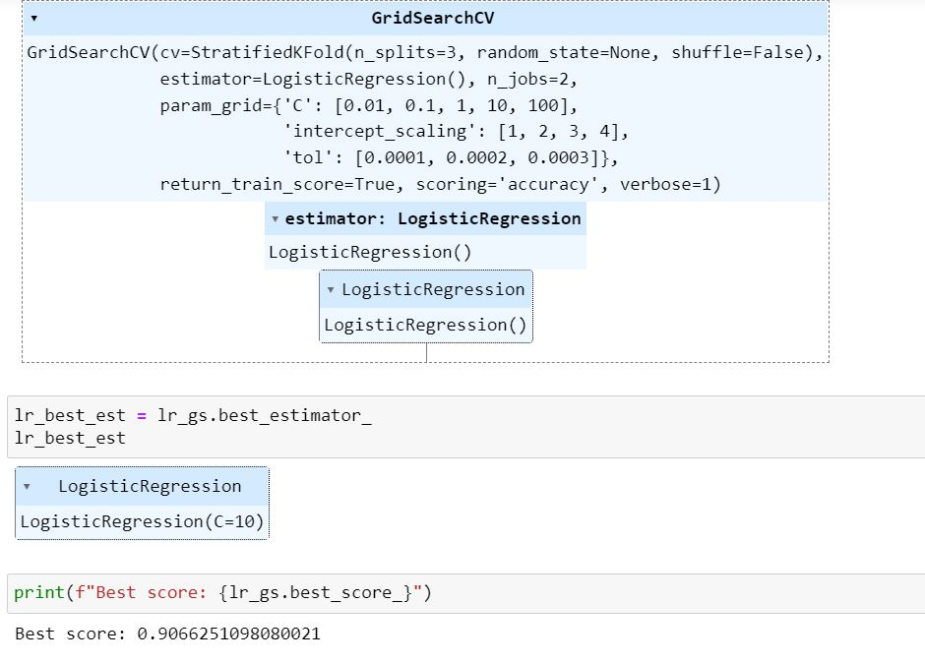
Cross val mean : 0.903
Score after tuning: 0.91

Slide 21
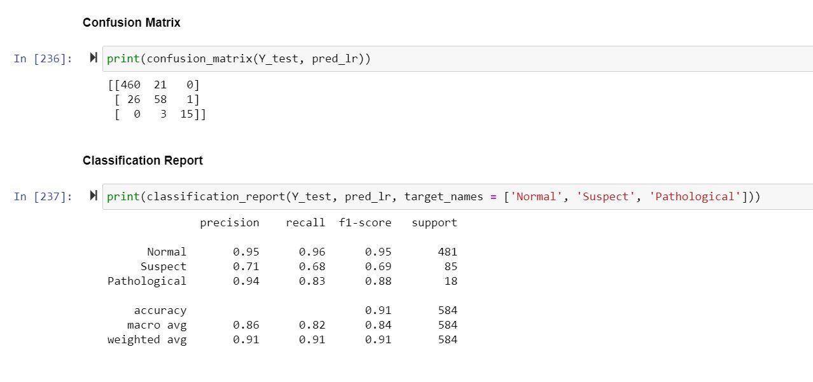
Performance of Logistic Regression

Slide 22
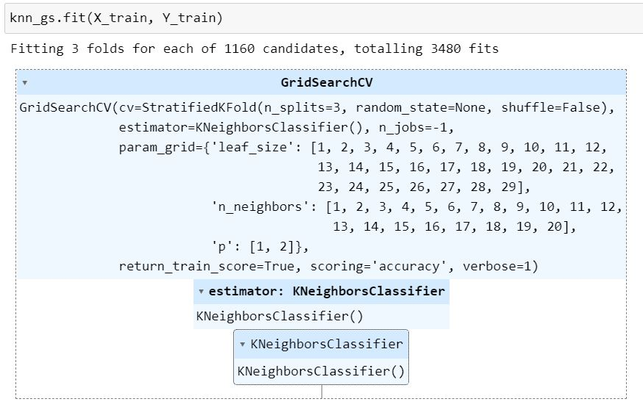
K-Nearest Neighbor
Cross val mean : 0.89
Score after tuning: 0.91

Slide 23
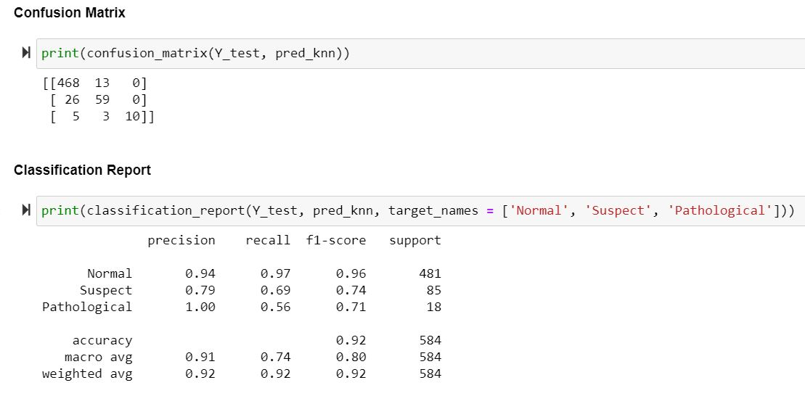
Performance of KNN

Slide 24
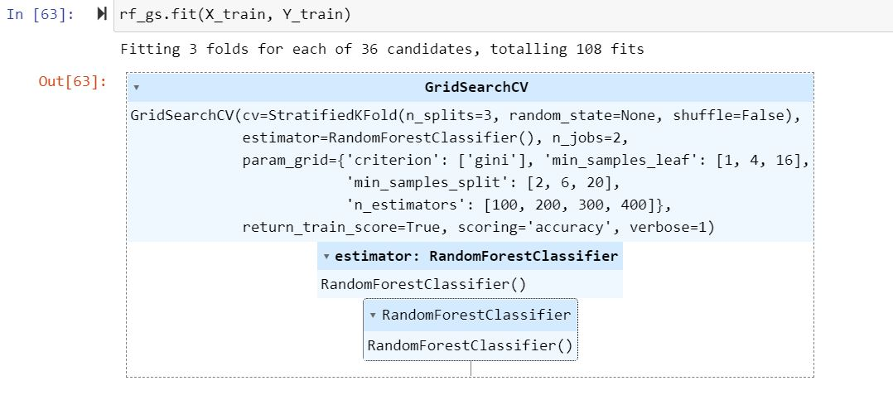
Random Forest Classifier
Cross val mean : 0.929
Score after tuning: 0.933

Slide 25
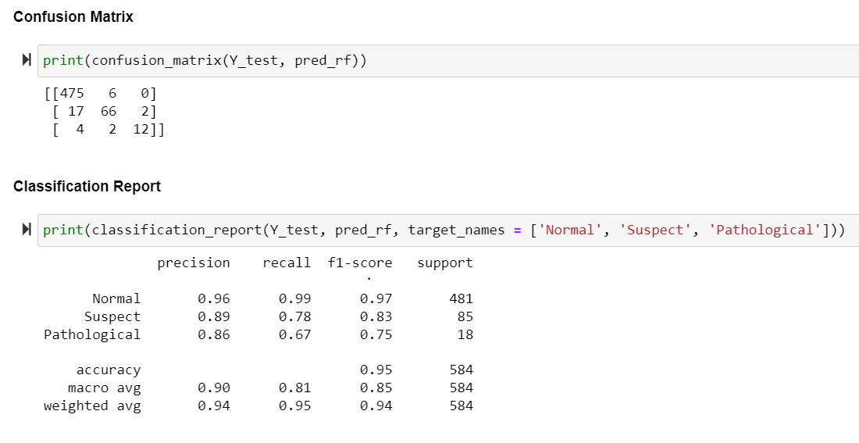
Performance of Random Forest

Slide 26
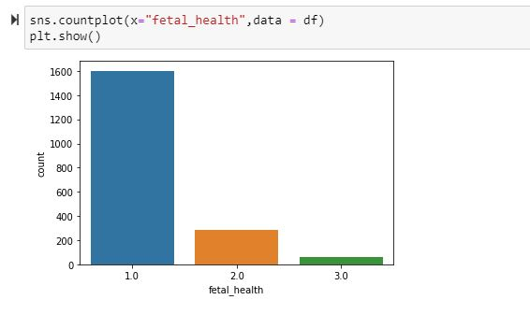
Data Imbalance
As we can see from this graph, 'fetal_health' feature is clearly imbalanced. Hence, we can use Up Sampling as our strategy to balance the data.
In RandomOverSampler or Up Sampling, we do sampling with replacement, which means we do random sampling in minority class, until it has the same number of instances as majority class. So, the instances in minority class will appear multiple times.

Slide 27
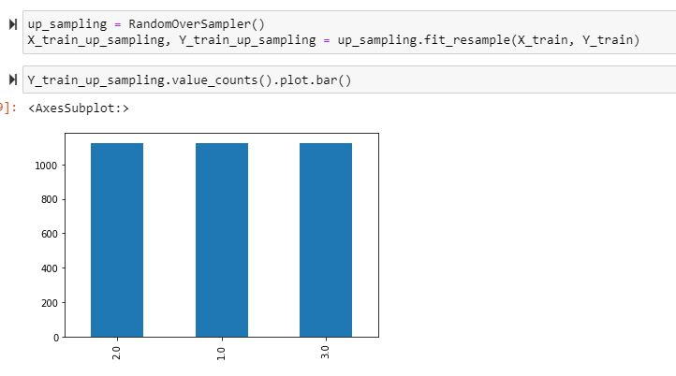

Slide 28
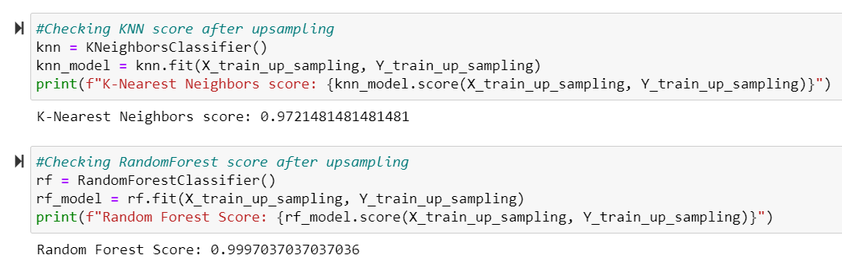
Model performance after UpSampling
We can see that after UpSampling, the scores of both the models have increased.

Slide 29
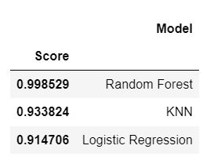
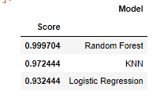
Results
After implementing all the models and observing the results, we can see that Random Forest with 0.998 score is the best performer among models. And, Logistic Regression has the lowest score 0.915 from Fig-1.
After up-sampling - The Fetal Health predictor column, which is imbalanced before the Random Forest is still the best performer, that being said KNN and Logistic Regression increased to 7% and 2% respectively from Fig-2.

Slide 30
Challenges
Understanding the medical jargons
Model training is time consuming

Slide 31
Thank You

